Slide 1
COVID-19 Vaccines
Snežna Rogelj, PhD

Slide 2
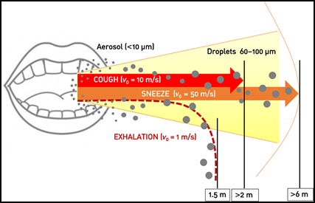
How you get infected with SARS-CoV-2

Slide 3
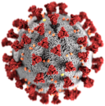
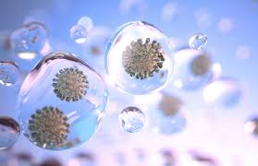
How you get infected with SARS-CoV-2
10⁶/ml
~0.1um

Slide 4
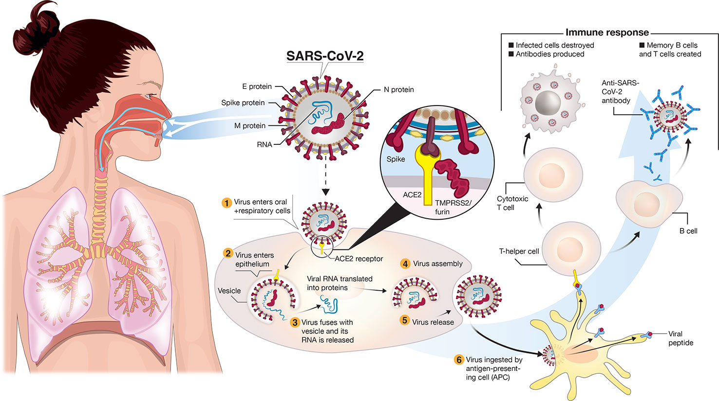
How your body is infected with SARS-CoV-2
Adaptive & lasting
Transmembrane Serine Protease 2
many different proteins

Slide 5
How your body is infected with SARS-CoV-2
Adaptive & lasting
RNA instructions for building
the whole virus (=many proteins)
Transmembrane Serine Protease 2
many different proteins
One in => 100 out

Slide 6
How your immune system responds to SARS-CoV-2
Transmembrane Serine Protease 2

Slide 7
How your immune system responds to SARS-CoV-2
Versatile, adaptive &
lasting immunity:
complex & takes
time to develop
Transmembrane Serine Protease 2

Slide 8
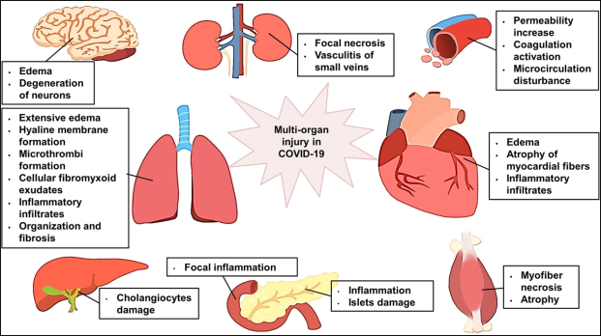
How your body is infected with SARS-CoV-2
Adaptive & lasting
Organs
infected & affected
Transmembrane Serine Protease 2
One in => 100 out

Slide 9
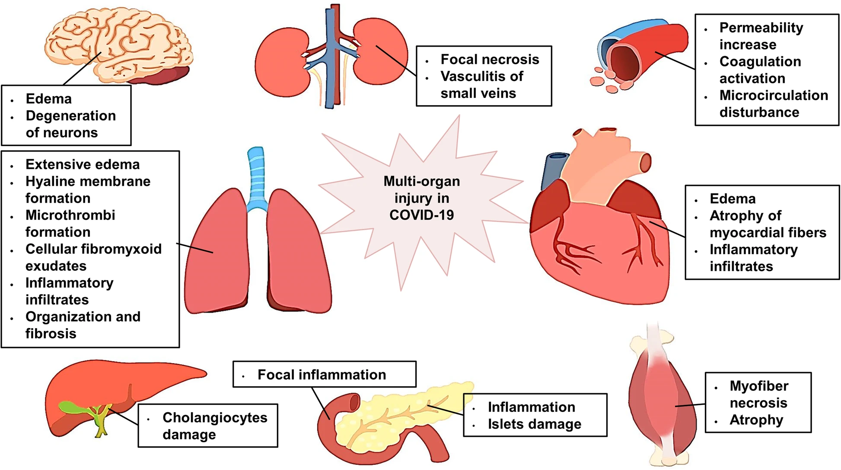
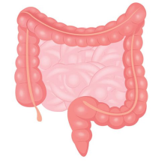
One-two-three punch: blood volume dysregulation + viral damage + inflammation
Smell, taste
Cytokine Storm
intestines
insulin

Slide 10
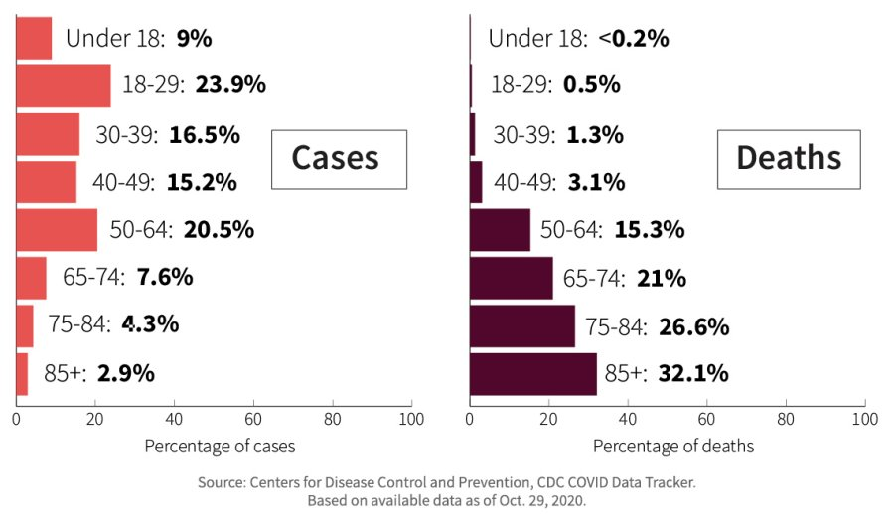
95% of Americans killed by COVID-19 were 50 or older
https://www.aarp.org/health/conditions-treatments/info-2020/coronavirus-deaths-older-adults.html

Slide 11
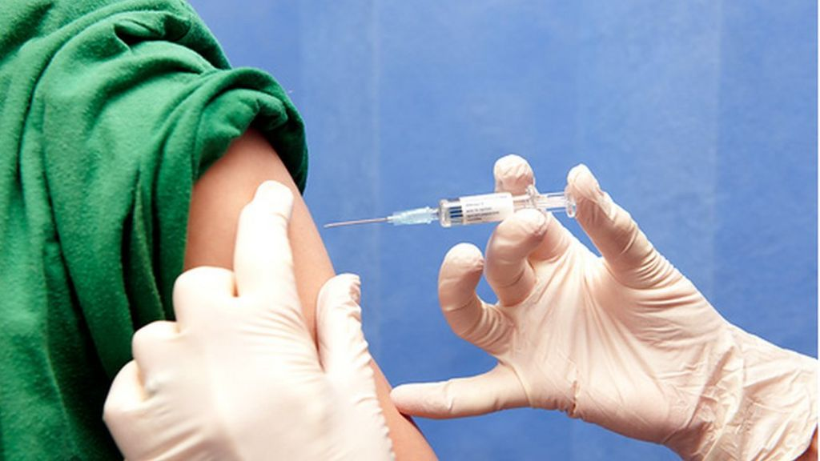
How to prevent acute SARS-CoV-2 infections? Pre-alert and train the immune system

Slide 12
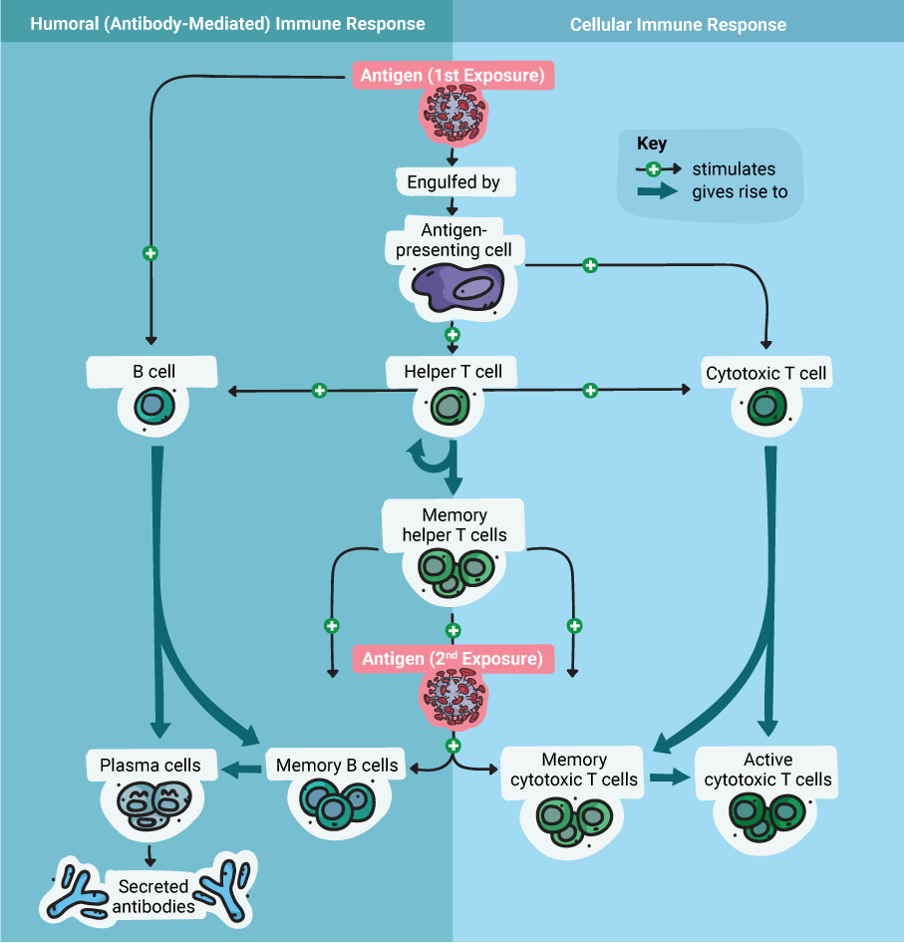
How immune system works
https://www.promegaconnections.com/covid-19-vaccines-adenoviral-vectors/

Slide 13
How immune system works
Make antibodies
that coat free virus
Kill infected cells
Remember next time(s)
https://www.promegaconnections.com/covid-19-vaccines-adenoviral-vectors/

Slide 14
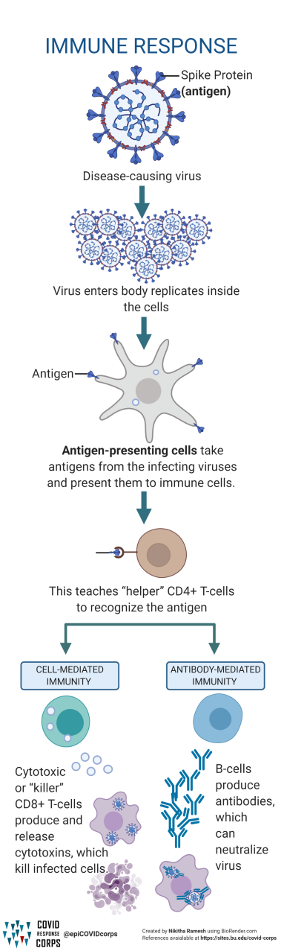
How immune system works
Types of Vaccines Infographics
https://www.intvetvaccnet.co.uk/blog/covid-19/vaccine-eight-types-being-tested

Slide 15
How immune system works
Types of Vaccines Infographics
https://www.intvetvaccnet.co.uk/blog/covid-19/vaccine-eight-types-being-tested

Slide 16

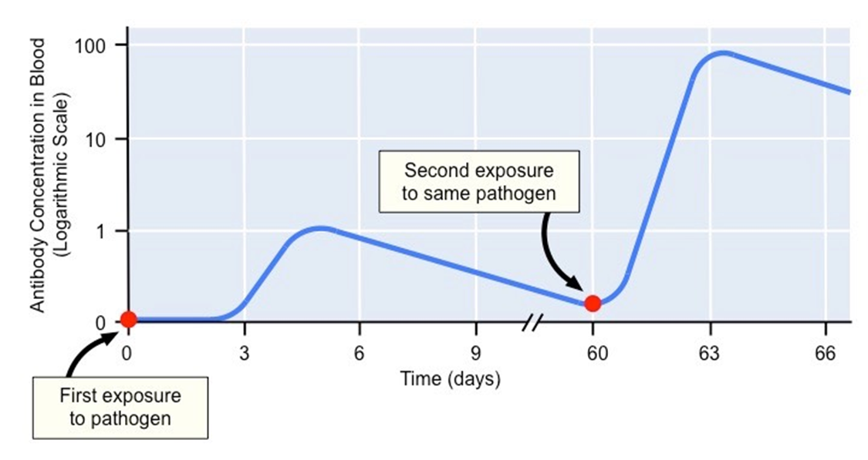
Antibody Response

Slide 17
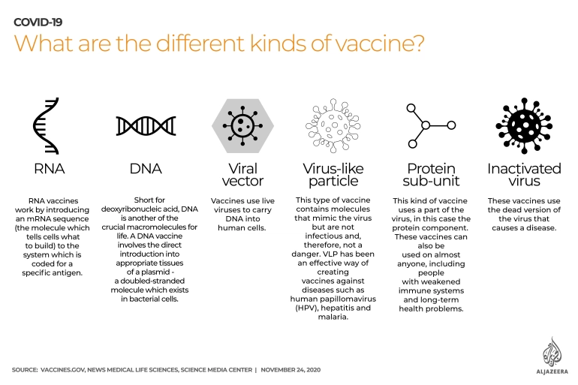
Options for building an immunity without actual SARS-CoV-2 infection
https://www.aljazeera.com/features/2020/11/24/covid-19-vaccines-explained-in-maps-and-charts

Slide 18
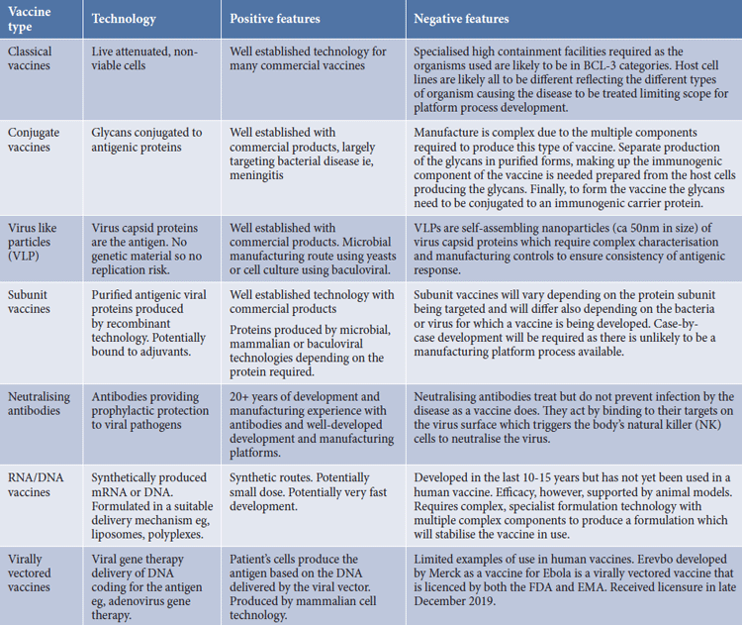
Building immune response without an infection: many ways, each with pluses & minuses
https://www.europeanpharmaceuticalreview.com/article/122275/comparison-of-new-vaccine-approaches-covid-19/

Slide 19
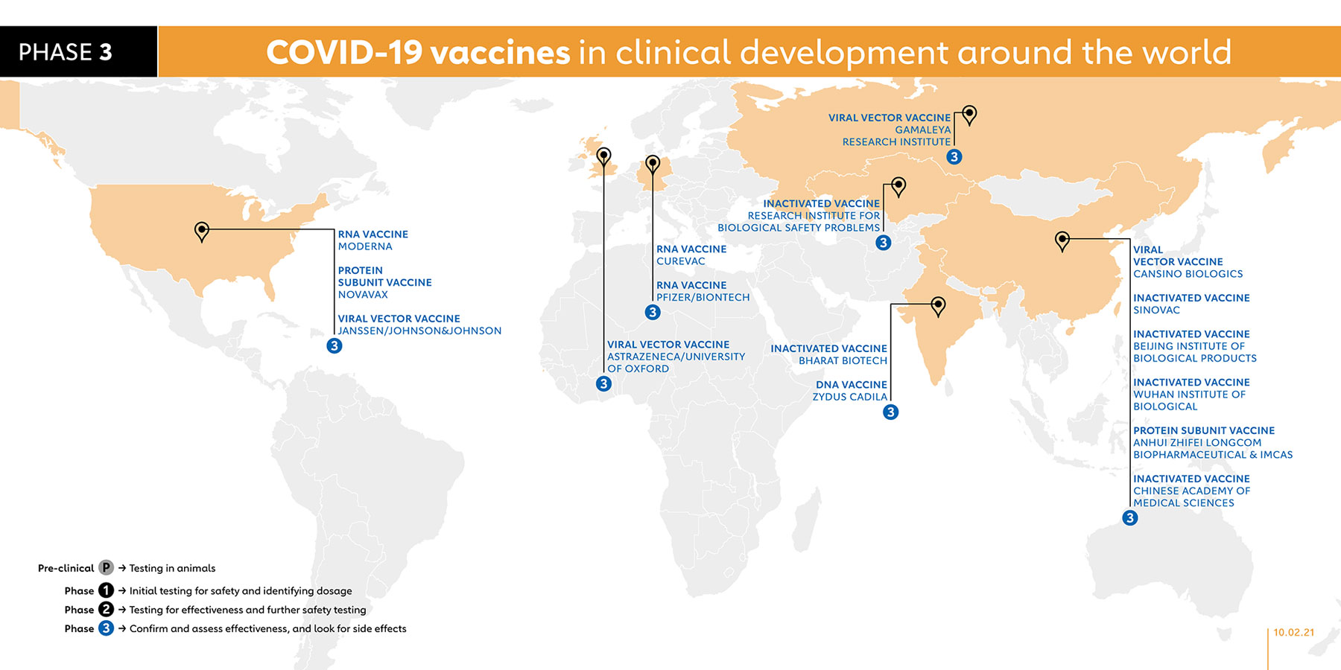
COVID vaccines in the USA: Pfizer and Moderna, J&J coming along soon
& PFIZER
Gavi The Vaccine Alliance: The COVID-19 vaccine race Feb. 10, 2021

Slide 20

Building immune response without COVID infection
Coronavirus
https://www.intvetvaccnet.co.uk/blog/covid-19/vaccine-eight-types-being-tested

Slide 21
Building immune response without COVID infection
Spike protein:
most visible to the immune system
coded in viral mRNA
one of many other proteins needed to make the full virus
https://www.intvetvaccnet.co.uk/blog/covid-19/vaccine-eight-types-being-tested

Slide 22
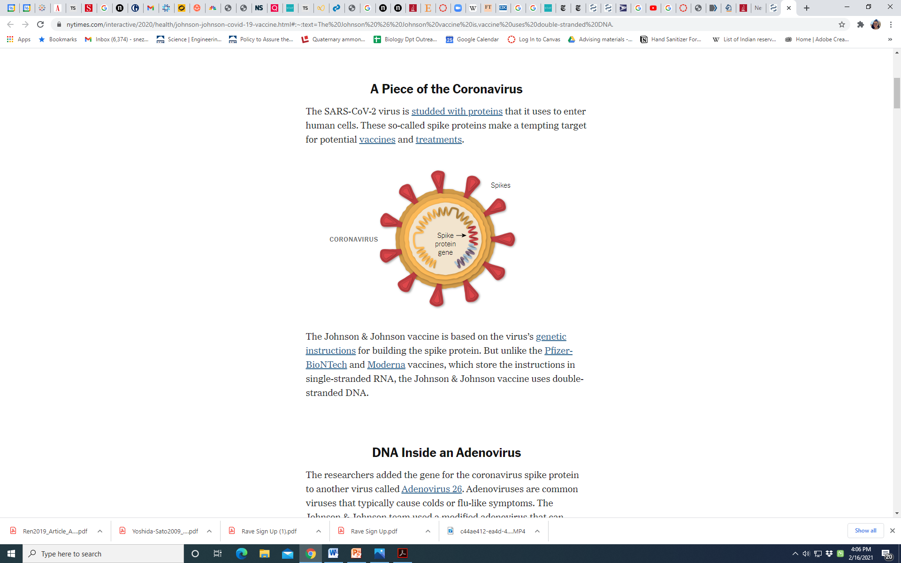
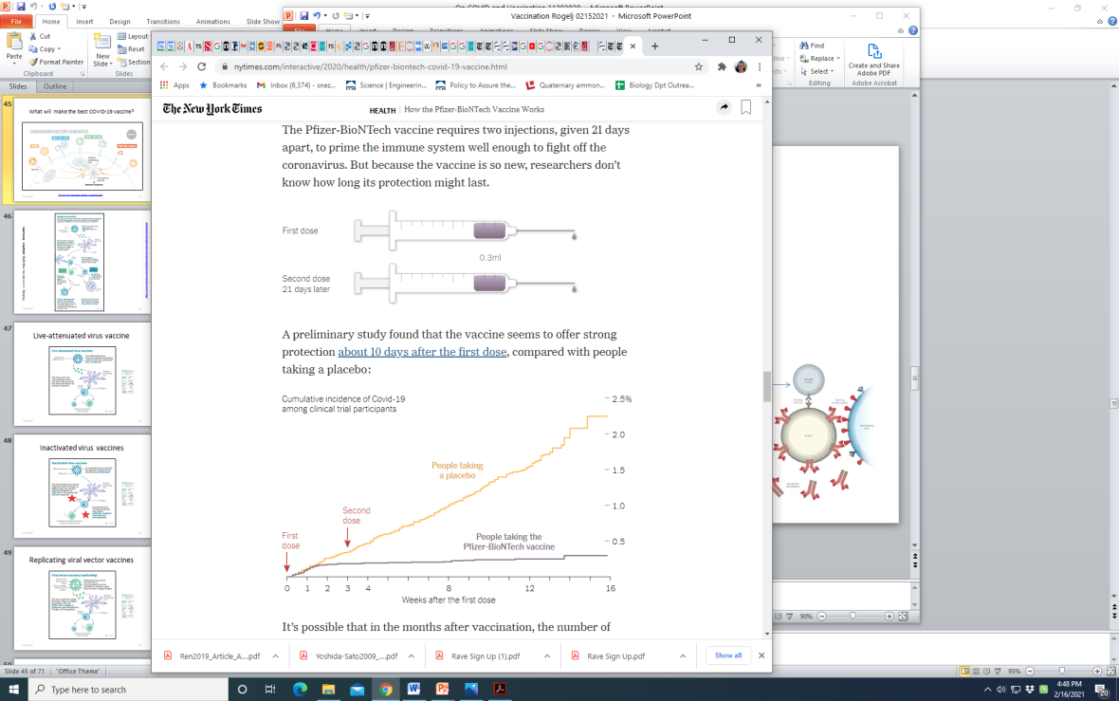

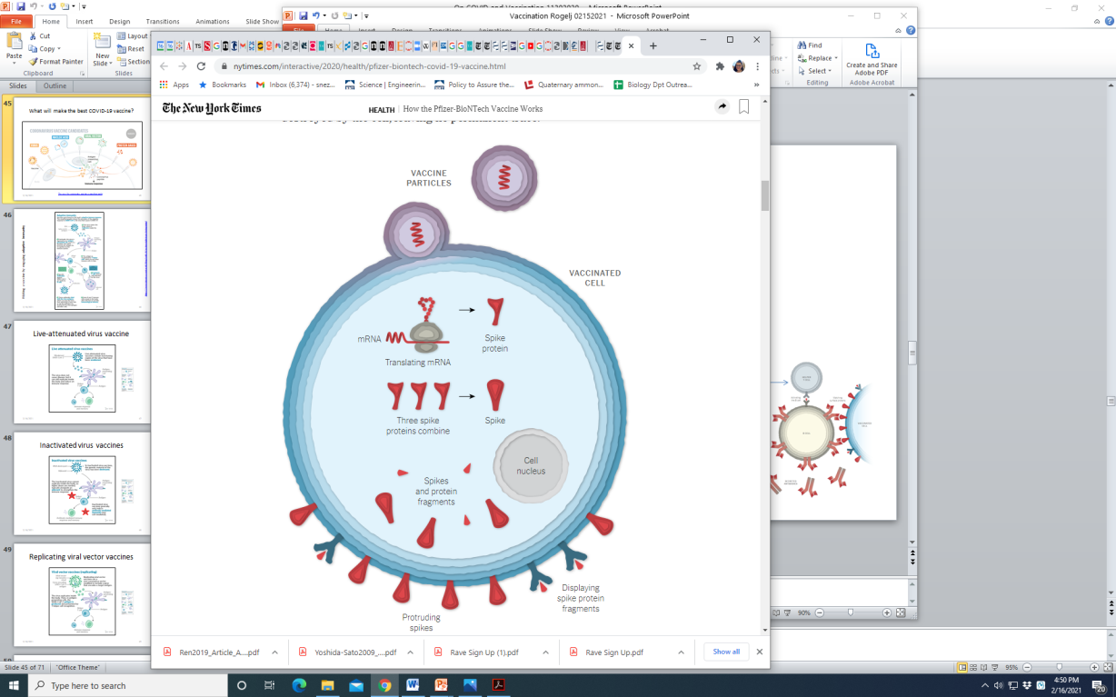
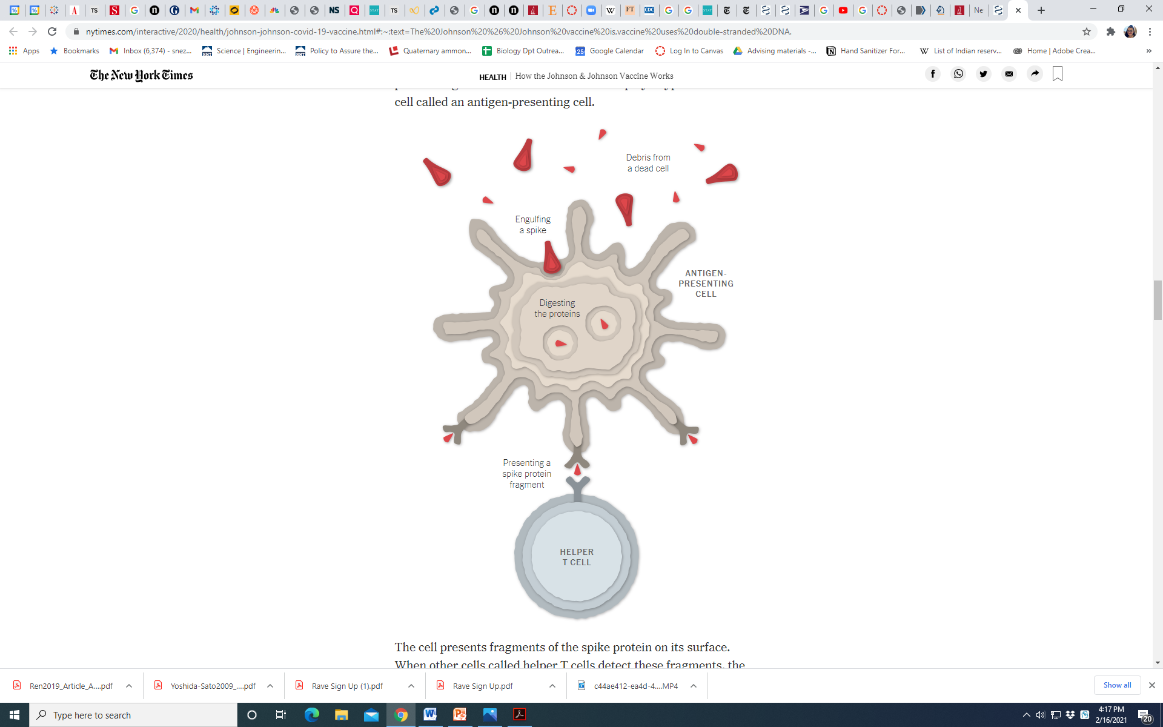
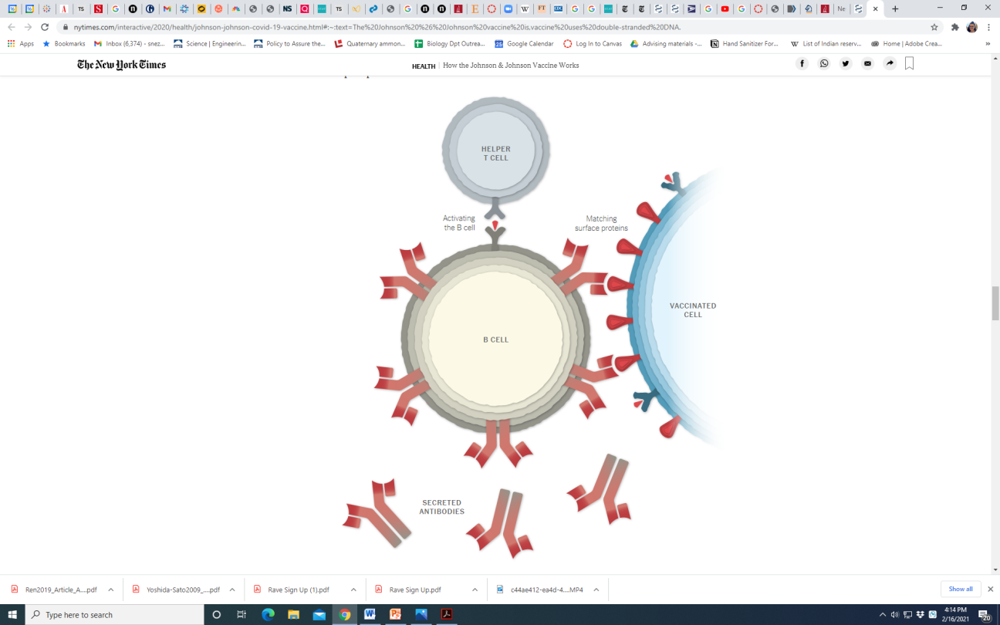
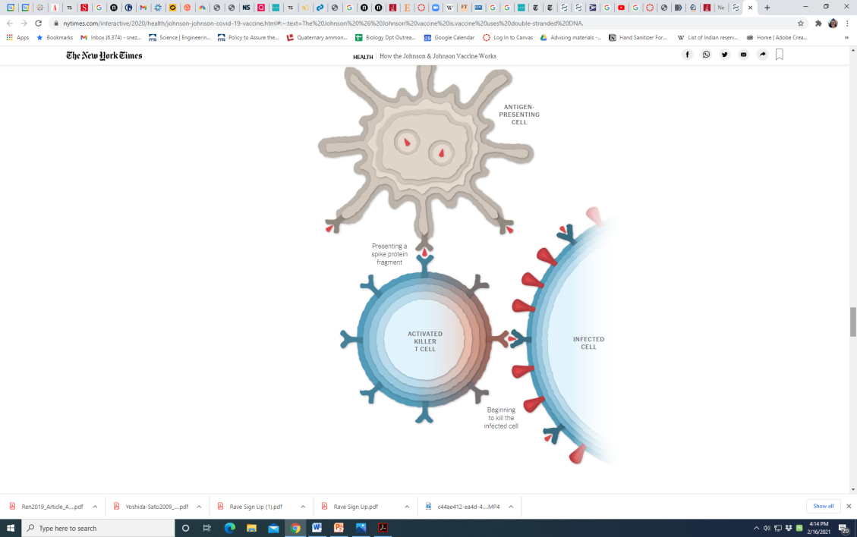
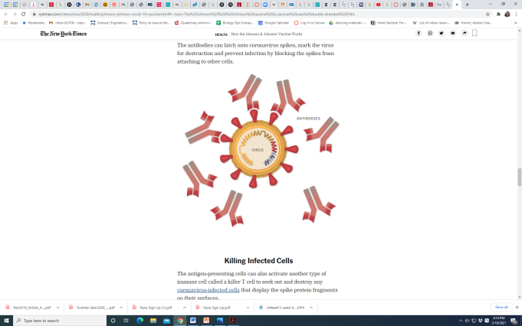
Pfizer Vaccine = Pfizer + BioNTech (German) = BNT162b2 = tozinameran = Comirnaty = 95% efficacy =0.3ml (30ug mRNA)
Stable at -20 for
Must be used in 6hr when thawed
RNA for “spike protein” ONLY
inside a protective lipid capsule
+
Memory B cells
to make antibody
& targeted T cells
when re-exposed
+

Slide 23
Pfizer Vaccine = Pfizer + BioNTech (German) = BNT162b2 = tozinameran = Comirnaty = 95% efficacy =0.3ml
Stable at -20 for
Must be used in 6hr when thawed

Slide 24
Pfizer Vaccine = Pfizer + BioNTech (German) = BNT162b2 = tozinameran = Comirnaty = 95% efficacy =0.3ml (30ug RNA)
Stable at -20 for
Must be used in 6hr when thawed
RNA for “spike protein” ONLY
inside a protective lipid capsule

Slide 25
Pfizer Vaccine = Pfizer + BioNTech (German) = BNT162b2 = tozinameran = Comirnaty = 95% efficacy =0.3ml
Stable at -20 for
Must be used in 6hr when thawed
RNA for “spike protein” ONLY
inside a protective lipid capsule

Slide 26
Pfizer Vaccine = Pfizer + BioNTech (German) = BNT162b2 = tozinameran = Comirnaty = 95% efficacy =0.3ml
Stable at -20 for
Must be used in 6hr when thawed
RNA for “spike protein” ONLY
inside a protective lipid capsule

Slide 27
Pfizer Vaccine = Pfizer + BioNTech (German) = BNT162b2 = tozinameran = Comirnaty = 95% efficacy =0.3ml
Stable at -20 for
Must be used in 6hr when thawed
RNA for “spike protein” ONLY
inside a protective lipid capsule

Slide 28
Pfizer Vaccine = Pfizer + BioNTech (German) = BNT162b2 = tozinameran = Comirnaty = 95% efficacy =0.3ml
Stable at -20 for
Must be used in 6hr when thawed
RNA for “spike protein” ONLY
inside a protective lipid capsule

Slide 29
Pfizer Vaccine = Pfizer + BioNTech (German) = BNT162b2 = tozinameran = Comirnaty = 95% efficacy =0.3ml
Stable at -20 for
Must be used in 6hr when thawed
RNA for “spike protein” ONLY
inside a protective lipid capsule
+

Slide 30
Pfizer Vaccine = Pfizer + BioNTech (German) = BNT162b2 = tozinameran = Comirnaty = 95% efficacy =0.3ml
Stable at -20 for
Must be used in 6hr when thawed
RNA for “spike protein” ONLY
inside a protective lipid capsule
+
Memory B cells
to make antibody
& targeted T cells
when re-exposed
+

Slide 31

Pfizer Vaccine = Pfizer + BioNTech (German) = BNT162b2 = tozinameran = Comirnaty = 95% efficacy =0.3ml
Stable at -20 for
Must be used in 6hr when thawed
RNA for “spike protein” ONLY
inside a protective lipid capsule
+
Memory B cells
to make antibody
& targeted T cells
when re-exposed
+
Protected: ~2 weeks after second dose

Slide 32
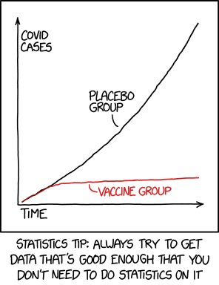
Protection can not be more obvious
Symptomatic
https://xkcd.com/2400/

Slide 33
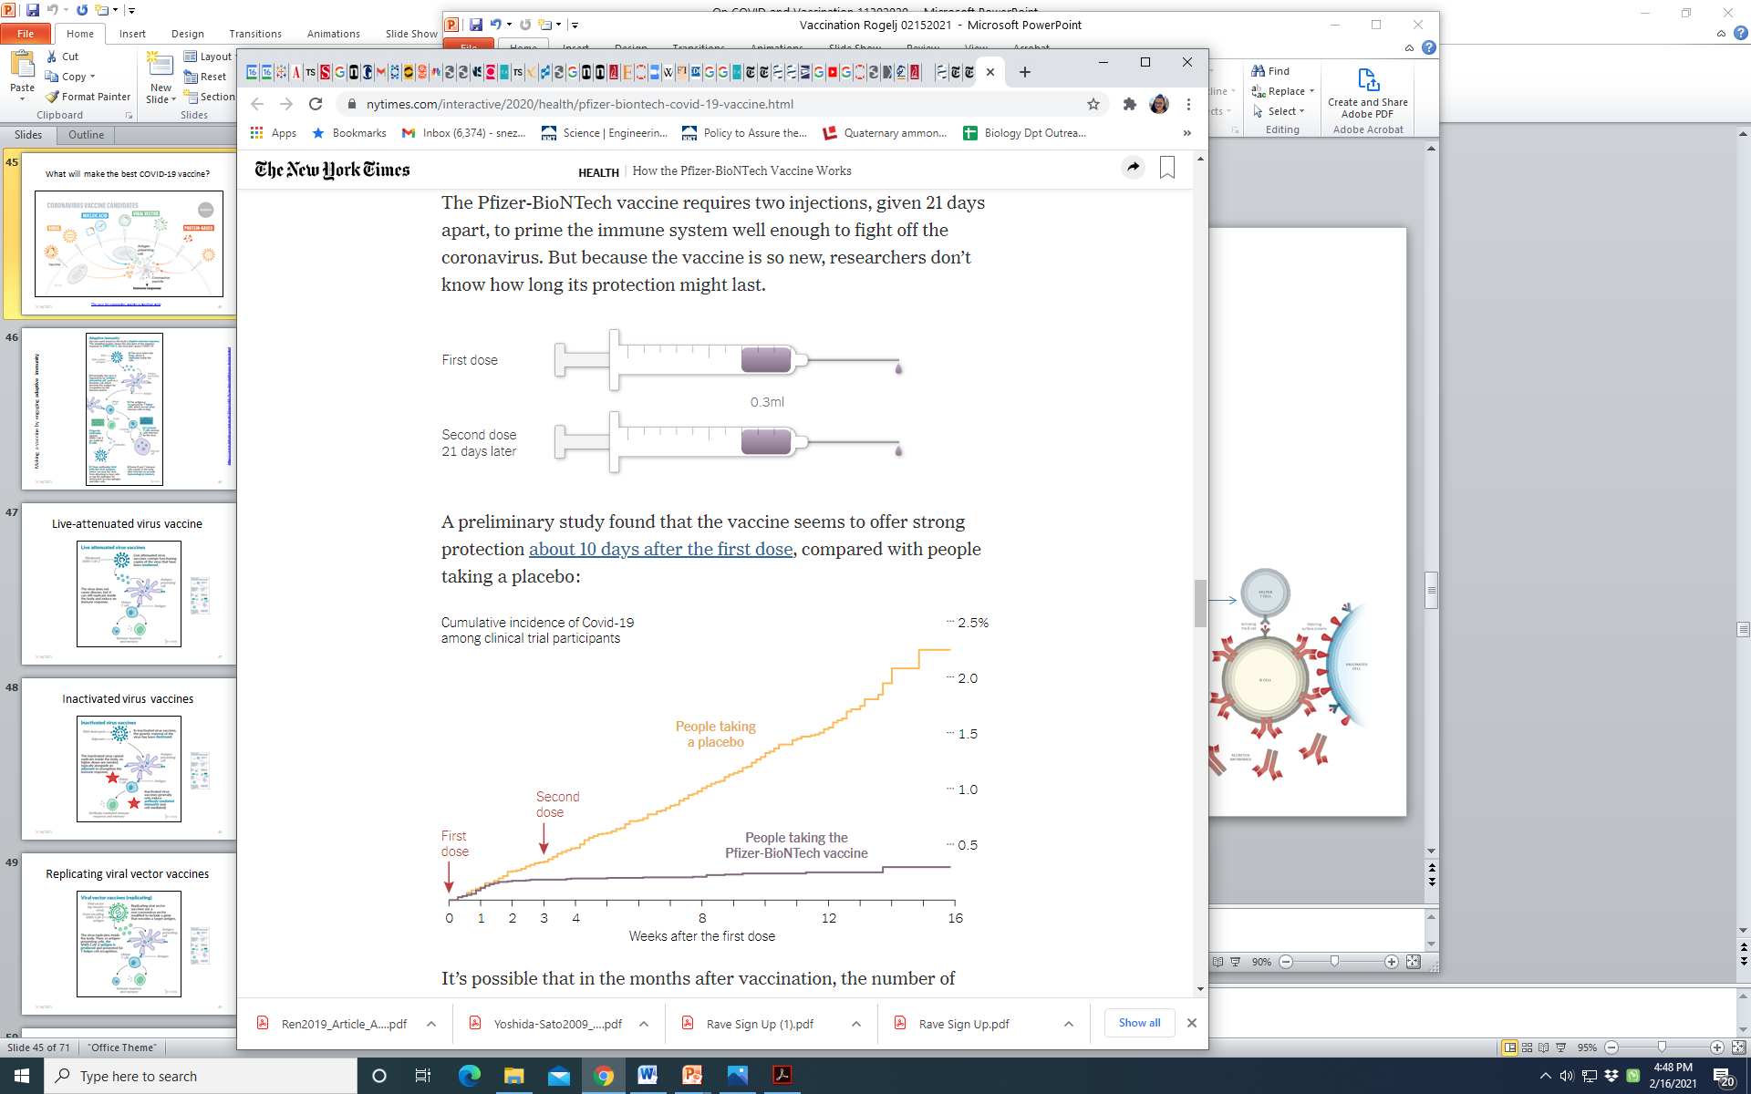
Pfizer Vaccine = Pfizer + BioNTech (German) = BNT162b2 = tozinameran = Comirnaty = 95% efficacy =0.3ml
168
BNT162b2
~40,000 volunteers
placebo controlled
8
https://www.nytimes.com/2020/12/13/learning/what-does-95-effective-mean-teaching-the-math-of-vaccine-efficacy.html

Slide 34
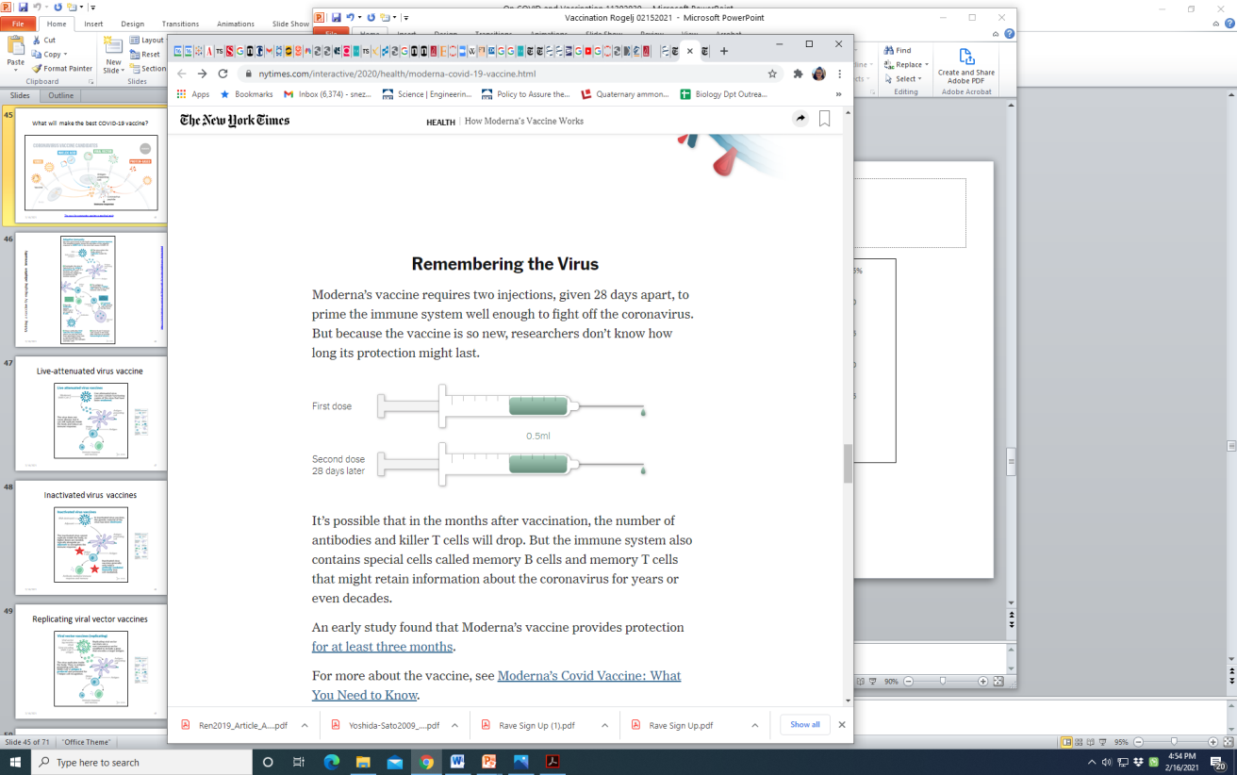

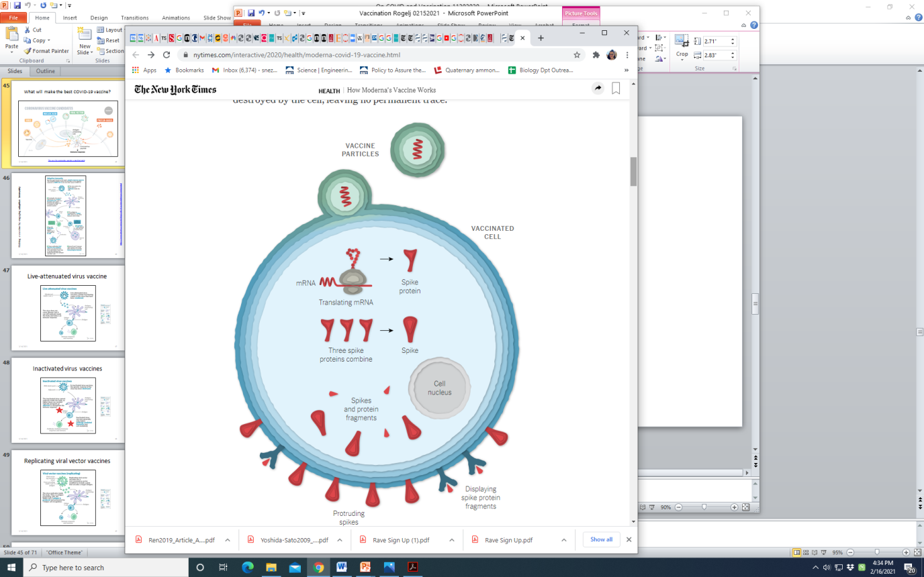
Moderna Vaccine = Moderna (MA, USA) + National Institutes of Health (NIH) = mRNA-1273 = 94.1% efficacy =0.5ml (100ug RNA)
Moderna SEC Filing
stable for up to six months when shipped
and stored at –4°F (–20°C)
RNA for “spike protein” ONLY
inside a protective lipid capsule
+
Memory B cells
to make antibody
& targeted T cells
when re-exposed
+
Protected: ~2 weeks after second dose

Slide 35


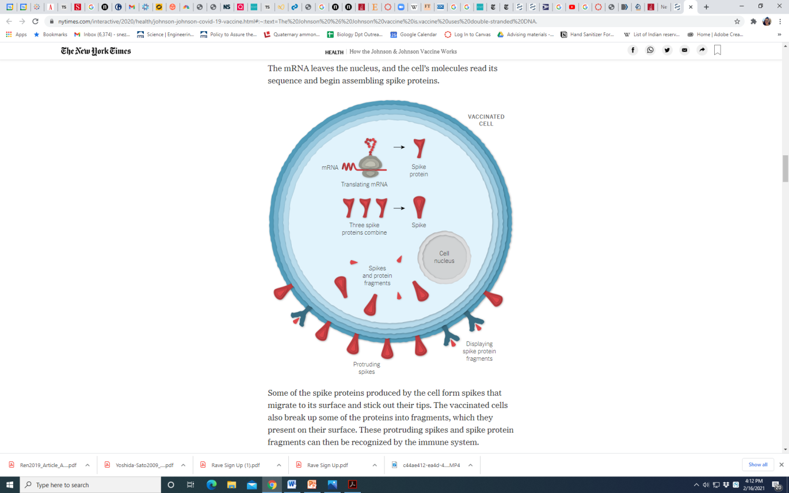
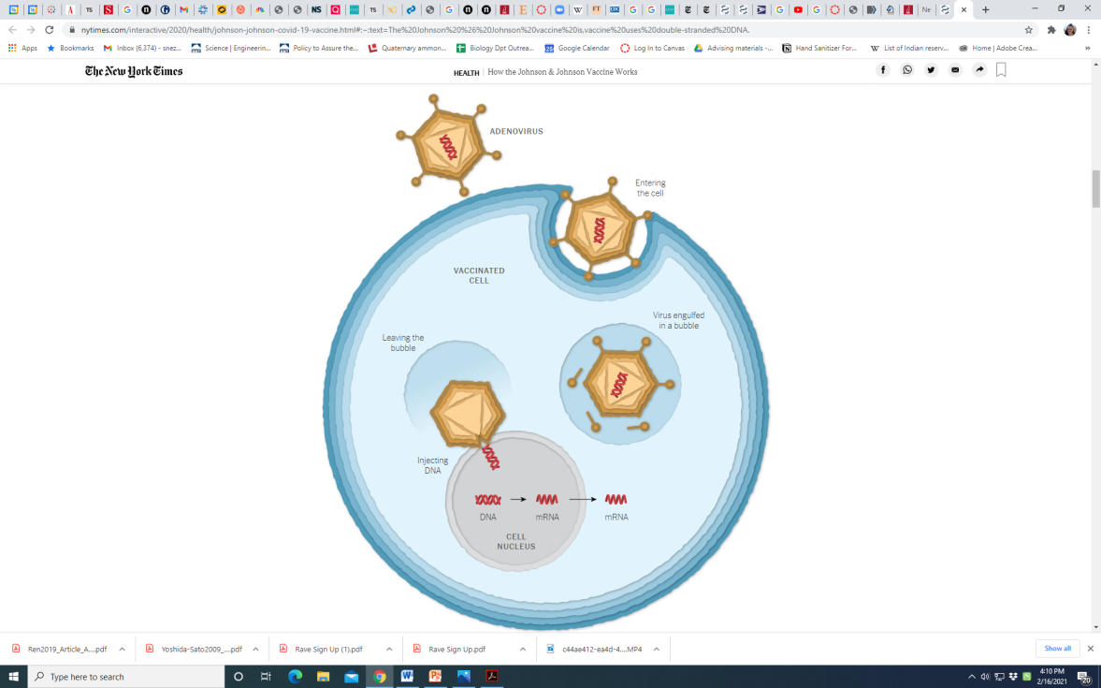

Johnson & Johnson Vaccine: = JNJ-78436735 or Ad26.COV2.S Janssen Pharmaceutics (Belgium) & Beth Israel Hospital (USA) = Single dose = ~72% efficacy
DNA=: continuously more mRNA
copies & thus more spike protein
DNA for spike protein
inside
an adenovirus
(cold virus that can infect but can not replicate)
+
Memory B cells
to make antibody
& targeted T cells
when re-exposed
+
Demonstrated complete protection against COVID-related hospitalization and death, 28 days post-vaccination. Jan 29, 2021

Slide 36
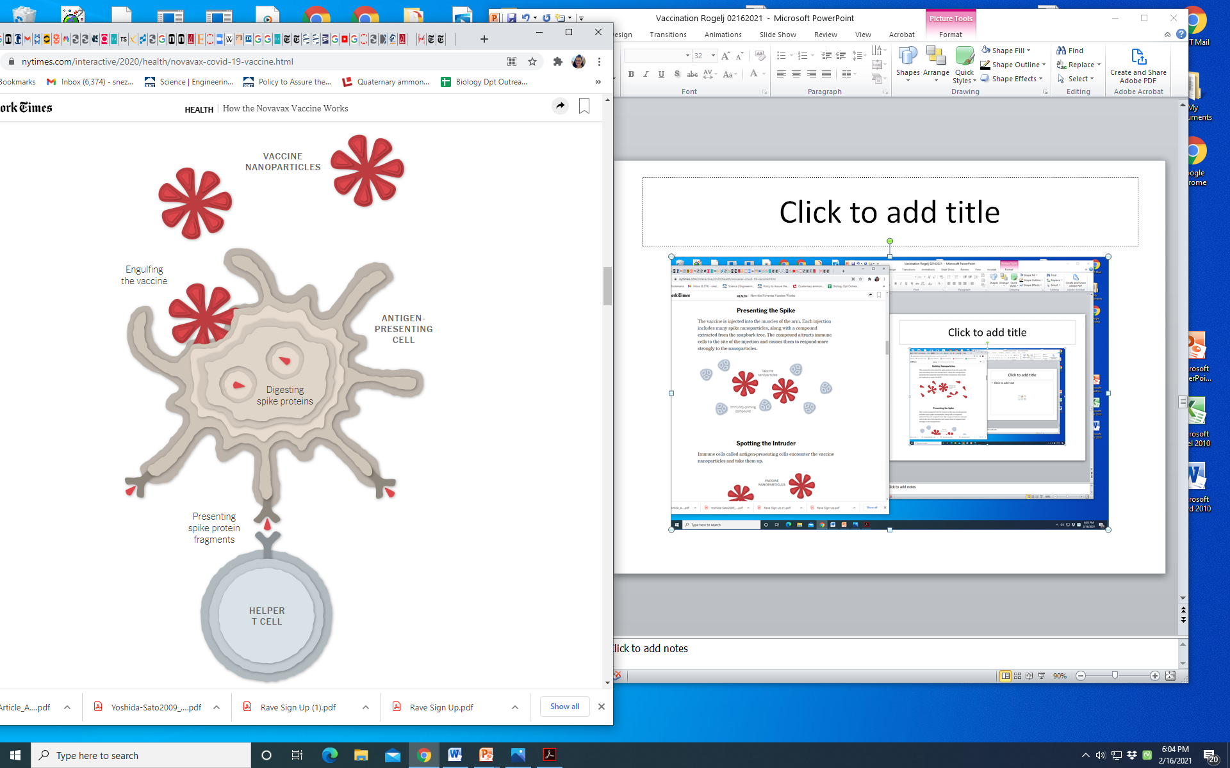
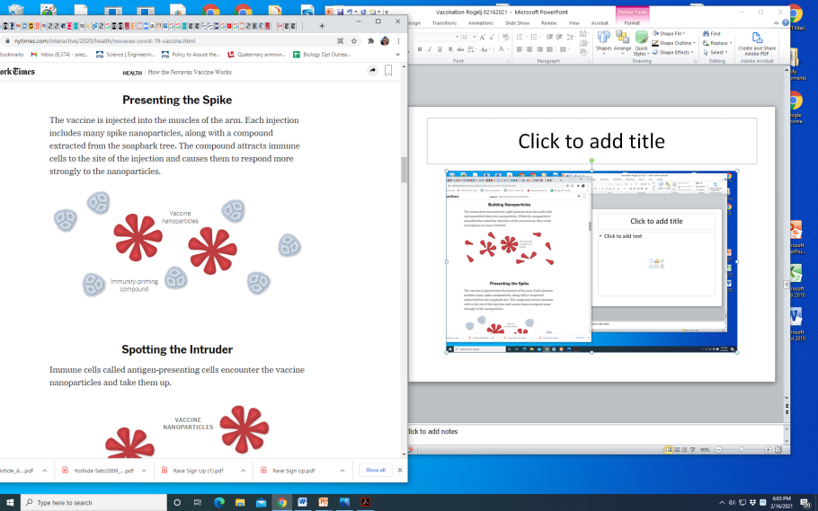
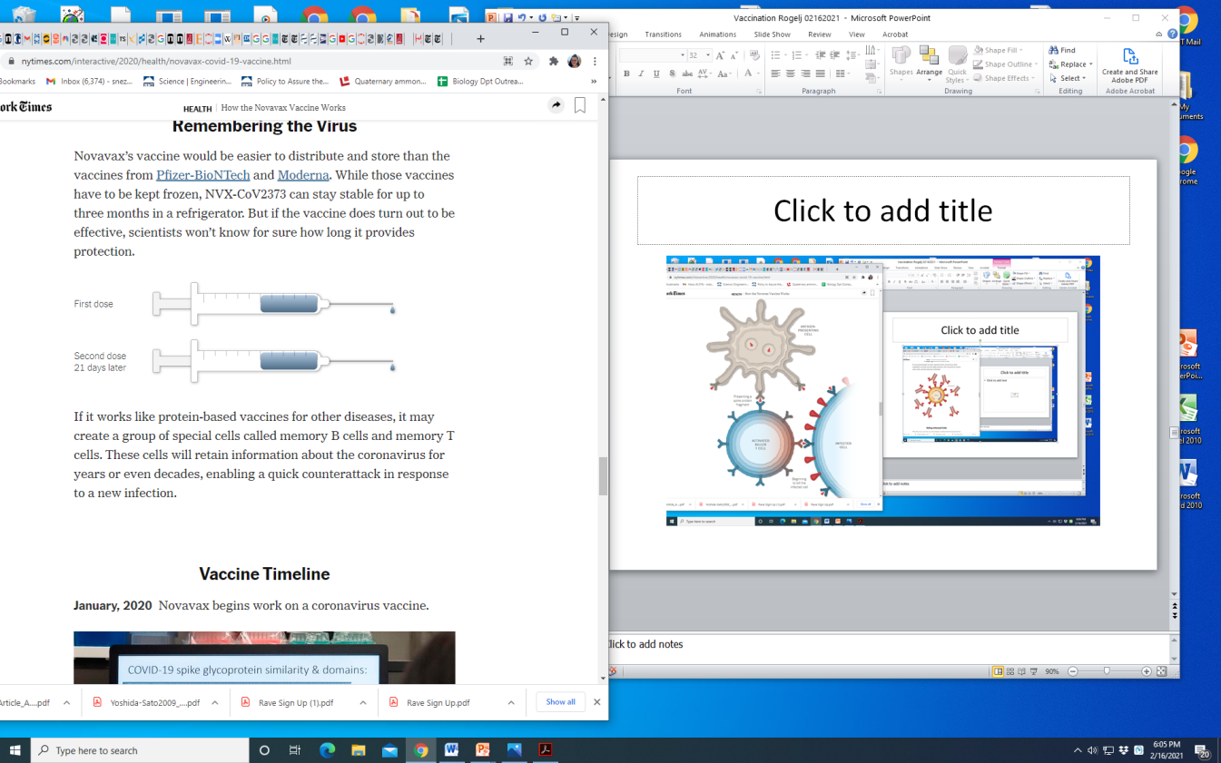
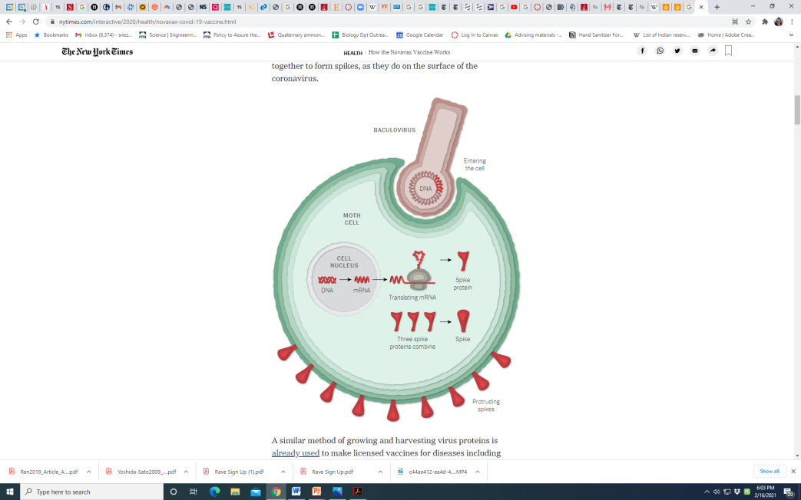
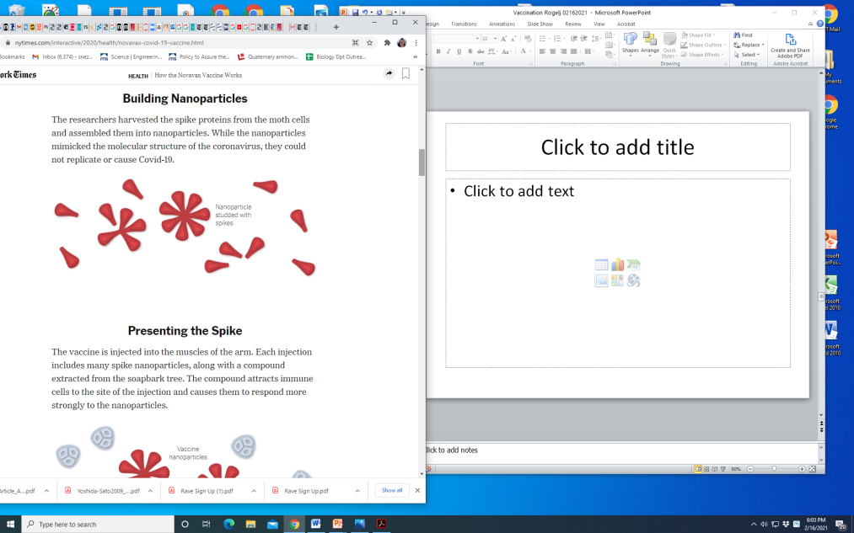
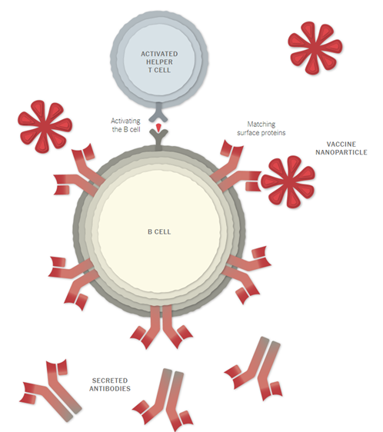
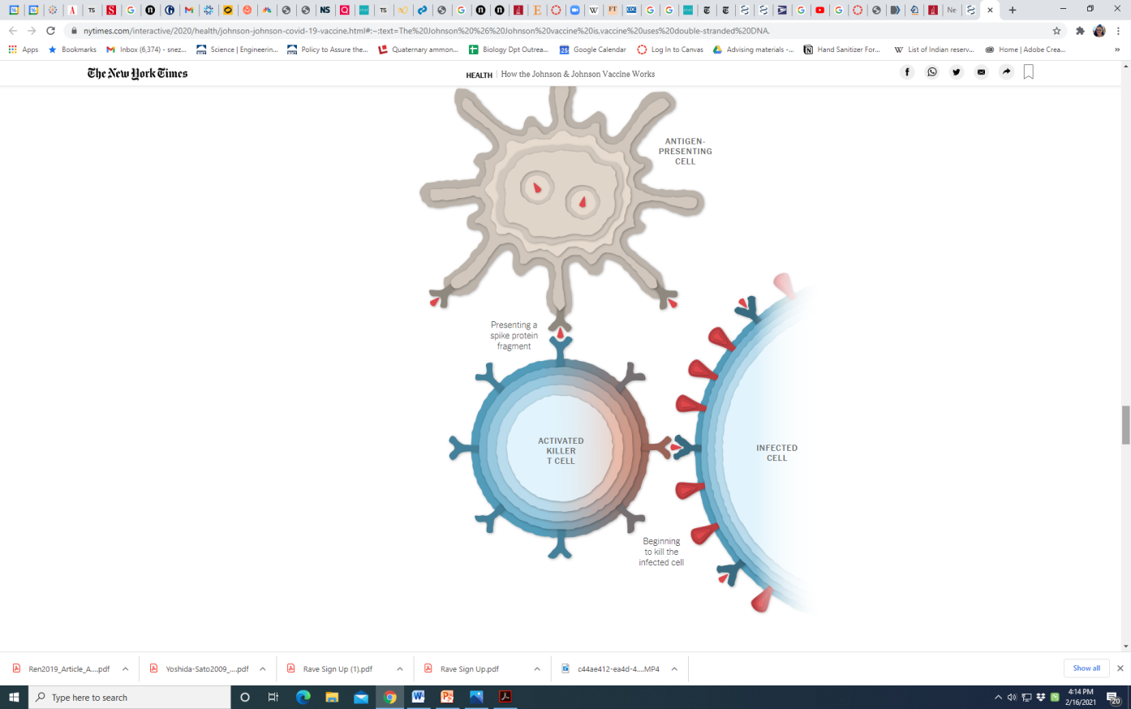
Novavax Vaccine: = NVX-CoV2373 Novavax (MD) = Double dose; protein based = ~89% efficacy; in Phase 3
“saponin”
Memory B cells
to make antibody
& targeted T cells
when re-exposed
+
+
Protected: ~2 weeks after second dose

Slide 37
Pfizer & Moderna vaccine ingredients
Pfizer:
mRNA (messenger ribonucleic acid, mRNA fragment that encodes the SARS-CoV-2 spike protein, only active ingredient in the vaccine, can NOT change your genes or DNA)
Lipids (to envelop & protect mRNA): (4-hydroxybutyl)azanediyl)bis(hexane-6,1-diyl)bis; (2-hexyldecanoate), 2 [(polyethylene glycol)-2000]-N,N-ditetradecylacetamide; 1,2-Distearoyl-snglycero-3- phosphocholine; cholesterol
Salts (balance the acidity): potassium chloride; monobasic potassium phosphate; sodium chloride; dibasic sodium phosphate dihydrate
Sugar (basic table sugar, helps maintain their shape during freezing): sucrose
Moderna :
mRNA (mRNA that encodes the spike protein): 1276 bases
Lipids (to envelop & protect mRNA): SM-102; 1,2-dimyristoyl-rac-glycero3-methoxypolyethylene glycol-2000 [PEG2000-DMG]; cholesterol; 1,2-distearoyl-snglycero-3-phosphocholine [DSPC]
Acids: acetic acid
Acid Stabilizers: Tromethamine & Tromethamine hydrochloride
Salts: Sodium acetate
Sugar: Sucrose
A Simple Breakdown of the Ingredients in the COVID Vaccines

Slide 38
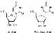
Pfizer & Moderna vaccine ingredients
Pfizer:
mRNA (messenger ribonucleic acid, mRNA fragment that encodes the SARS-CoV-2 spike protein, only active ingredient in the vaccine, can NOT change your genes or DNA)
Lipids (to envelop & protect mRNA): (4-hydroxybutyl)azanediyl)bis(hexane-6,1-diyl)bis; (2-hexyldecanoate), 2 [(polyethylene glycol)-2000]-N,N-ditetradecylacetamide; 1,2-Distearoyl-snglycero-3- phosphocholine; cholesterol
Salts & buffer (balance the acidity): potassium chloride; monobasic potassium phosphate; sodium chloride; dibasic sodium phosphate dihydrate
Sugar (basic table sugar, helps maintain their shape during freezing): sucrose
Moderna :
mRNA (mRNA that encodes the spike protein): 1276 bases
Lipids (to envelop & protect mRNA): SM-102; 1,2-dimyristoyl-rac-glycero3-methoxypolyethylene glycol-2000 [PEG2000-DMG]; cholesterol; 1,2-distearoyl-snglycero-3-phosphocholine [DSPC]
Acids: acetic acid
Acid Stabilizers: Tromethamine & Tromethamine hydrochloride (buffer)
Salts: Sodium acetate
Sugar: Sucrose
Anaphylaxis:
2-5/10E6 vs 1/5x10E3 flu
A Simple Breakdown of the Ingredients in the COVID Vaccines

